Slide 1
Applied Data Science papers
Zhangming Chan
AAIS, PKU

Slide 2
CONTENTS
POG: Personalized Outfit Generation for Fashion Recommendation at Alibaba iFashion
Automatic Generation of Pattern-controlled Product Description in E-commerce

Slide 3
POG: Personalized Outfit Generation for Fashion Recommendation at Alibaba iFashion
Wen Chen, Pipei Huang, Jiaming Xu, Xin Guo, Cheng Guo, Fei Sun, Chao Li, Andreas Pfadler, Huan Zhao, Binqiang Zhao

Slide 4
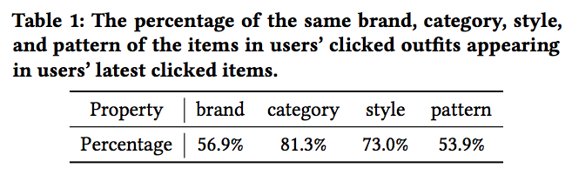
Motivations
Increasing demand for fashion recommendation raises a lot of challenges for online shopping platforms and fashion communities.
In particular, there exist two requirements for fashion outfit recommendation: the Compatibility of the generated fashion outfits, and the Personalization in the recommendation process.
Notes:
推荐的时候两点最重要：商品之间的兼容性和对个性化的考虑
之前的工作：直接考虑items之间的兼容性，或者直接去预测item的流行程度
还有将outfits预测当做是序列生成任务来做，但是着很明显是不合理的，因为在shuffle顺序的情况下，这些outfits的不应该发生变化但是序列生成是有序的
然后是persona部分，这部分更像是搜索而不是推荐，因为用户有着明确的动作，比如说对某个商品进行了点击
在分析现实情况的时候，取用户的最新的50次点击，然后发现相同品牌、品类、风格、款式这种同时出现在他们的outfits里面的概率分别是Table 1这么多种

Slide 5
Contributions
Personalized Outfit Generation (POG) model
significantly outperforms other alternative methods
deploy POG on the real-world outfit generation platform Dida
release a dataset

Slide 6
Model
Multi-modal Embedding
Fashion Outfit Model
Personalized Outfit Generation Model
Dida Platform
Notes:
前面说了之前很多工作都是把时装生成当做是一个序列生成任务来做，然后用一个LSTM之类的来建模，但是这有个问题就是，给了model一个很强的序列信息，但是这个信息很明显就是不应该存在的
而在考虑模型是否合适的时候，应该考虑的当前商品跟所有商品的一个关系，比如就是蓝外套 红裤子 白手套，前两者的关联程度应该是要高于后两者的
早期的工作一般都是用协同过滤之类方式根据用户的历史行为来对偏好进行建模，但是这种方式的实际上大部分关注于但商品的推荐，但是实际上推荐的时候很需要去对用户推荐出一个互补的衣服

Slide 7
Multi-modal Embedding
dense vector encoding the white background picture of the item from a CNN model
dense vector encoding the title of the item obtained from a TextCNN network, which has been pre-trained to predict an item’s leaf category based on its title
dense vector encoding a collaborative filtering signal for the item using Alibaba’s proprietary Behemoth Graph Embedding platform
Notes:
用一个CNN去对所有的图片进行编码
用一个TextCNN去对商品的所有item进行一个编码，预训练好的，可以用来预测商品的种类
用阿里巴巴的Behemoth Graph Embedding来编码一个协同过滤的信号，这个是基于用户的点击的数据，就是在用户一段时间的点击中，商品的共线出现的次数
这三个embedding直接concat起来

Slide 8
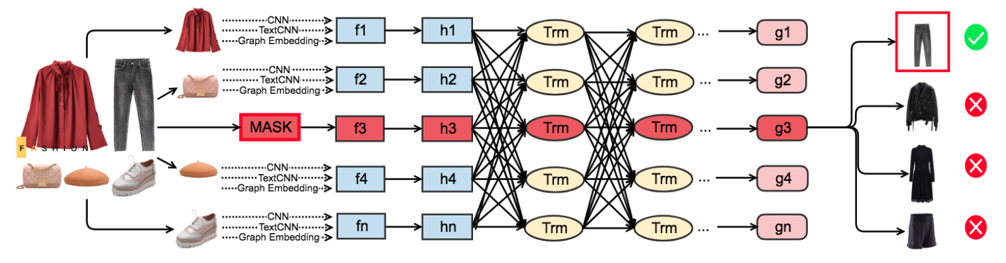
Fashion Outfit Model
a masked item prediction task based on a bidirectional Transformer encoder architecture

Slide 9
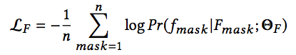
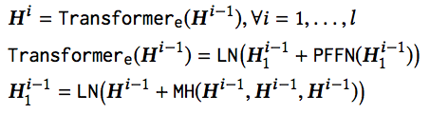
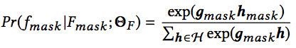
Fashion Outfit Model
Notes:
就是一个Masked Transformer的套路
首先是过一个MLP，然后不停的用几层Transformer迭代
用那个特殊的MASK符号的元素去做商品种类的预测，预测的时候是将从Transformer迭代之后的g_mask跟没迭代之前的h_mask相乘，然后g_mask跟前面的每一个h相乘的的一个班softmax
将所有的商品set都经过训练，这样的话就可以让每个商品之间的关系都被关注到
然后做出一个比LSTM效果更好的预测

Slide 10
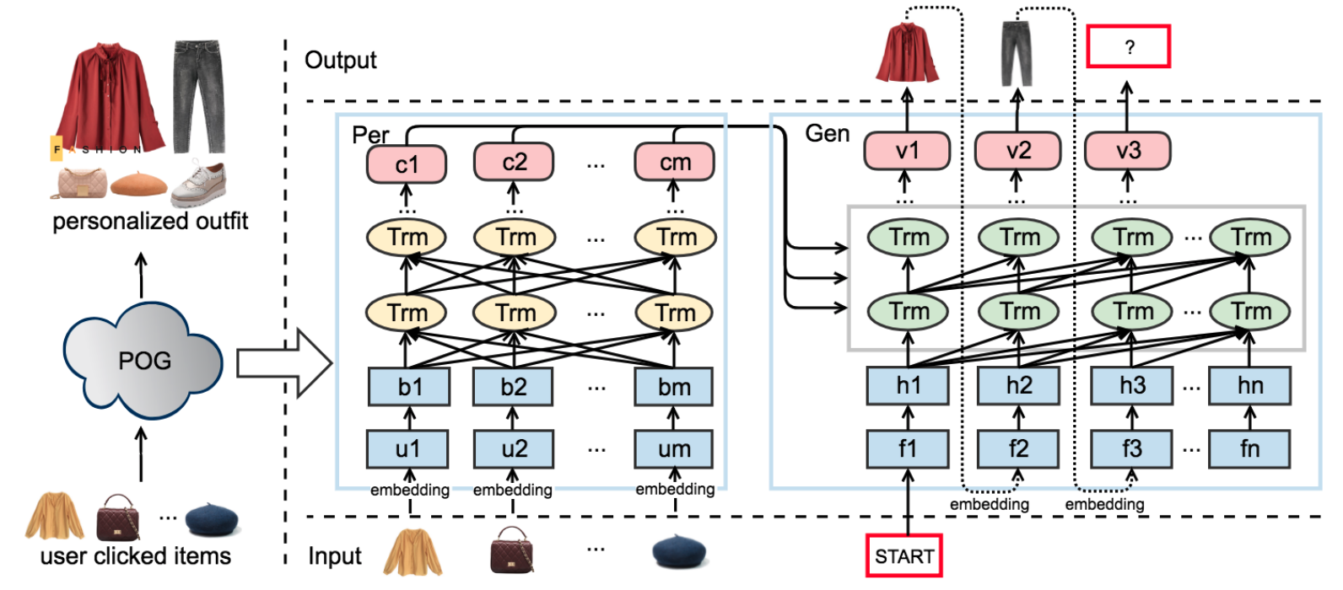
Personalized Outfit Generation Model
Take the advantage of encoder-decoder structure, we aim to translate an user’s historical behaviors to a personalized outfit.

Slide 11
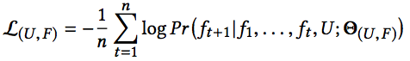
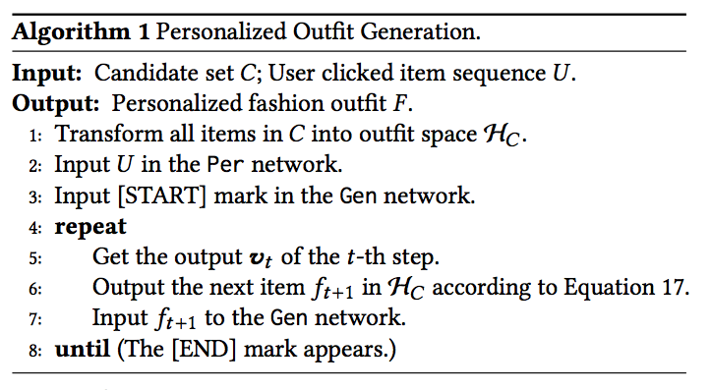
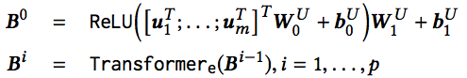
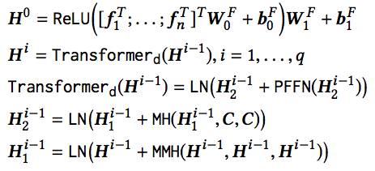
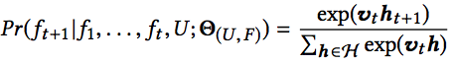
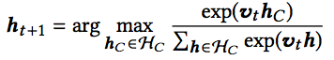
Personalized Outfit Generation Model
Notes:
U，F是模型的参数，就是在Persona信息跟其他商品的情况下做一个商品的生成
还是过两层MLP的Embedding，就是用户对商品的点击

Slide 12
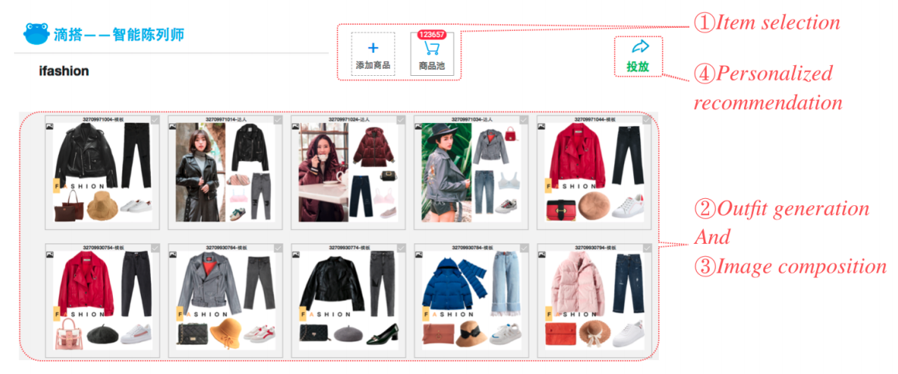
Dida Platform

Slide 13
Experiment
Fill In the Blank (FITB)
Compatibility Prediction (CP)
Notes:
FITB，就是每次我musk掉一个商品，然后做预测，在这实验中是四选一的一个设定
将数据集中构建出一个兼容的数据集，然后将不兼容的随机的选择一些服装的服饰，这里用AUC来衡量效果

Slide 14
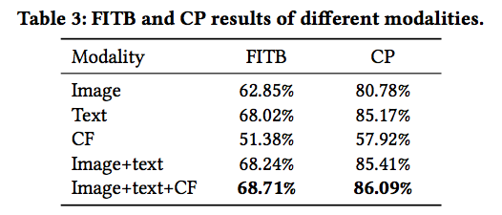
Experiment
Compare Different Modalities
Notes:
FITB，就是每次我musk掉一个商品，然后做预测，在这实验中是四选一的一个设定
将数据集中构建出一个兼容的数据集，然后将不兼容的随机的选择一些服装的服饰，这里用AUC来衡量效果

Slide 15
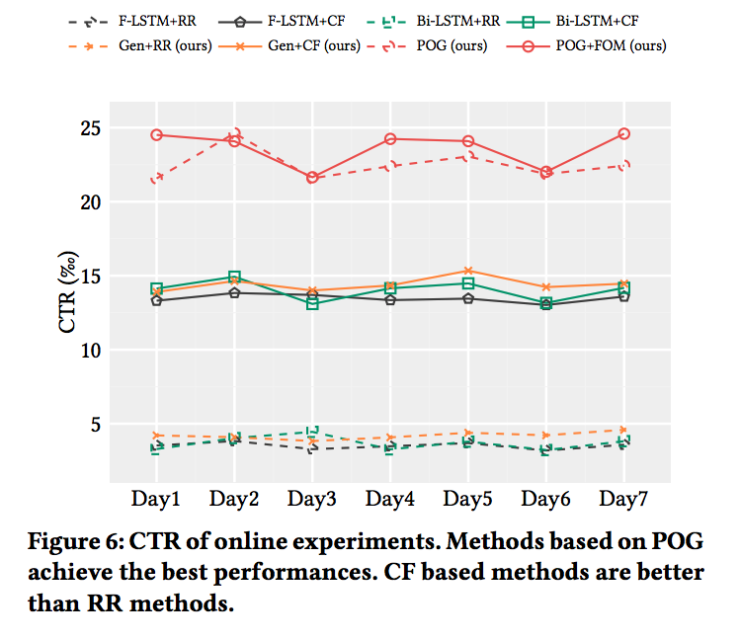
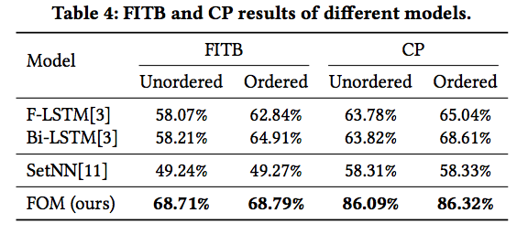
Experiment
Compare Different Models
Notes:
FITB，就是每次我musk掉一个商品，然后做预测，在这实验中是四选一的一个设定
将数据集中构建出一个兼容的数据集，然后将不兼容的随机的选择一些服装的服饰，这里用AUC来衡量效果

Slide 16
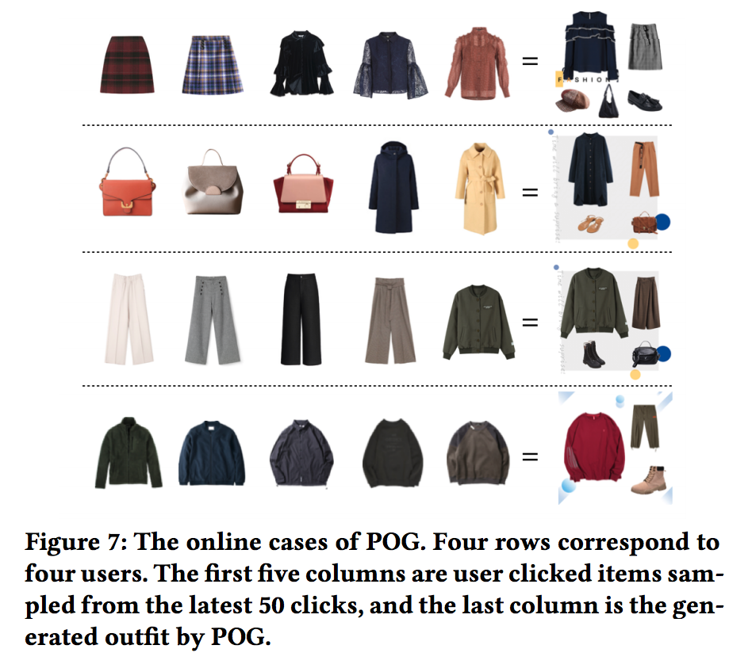
Experiment

Slide 17
Conclusion

Slide 18
Automatic Generation of Pattern-controlled Product Description in E-commerce
Tao Zhang, Jin Zhang, Chengfu Huo, Weijun Ren

Slide 19
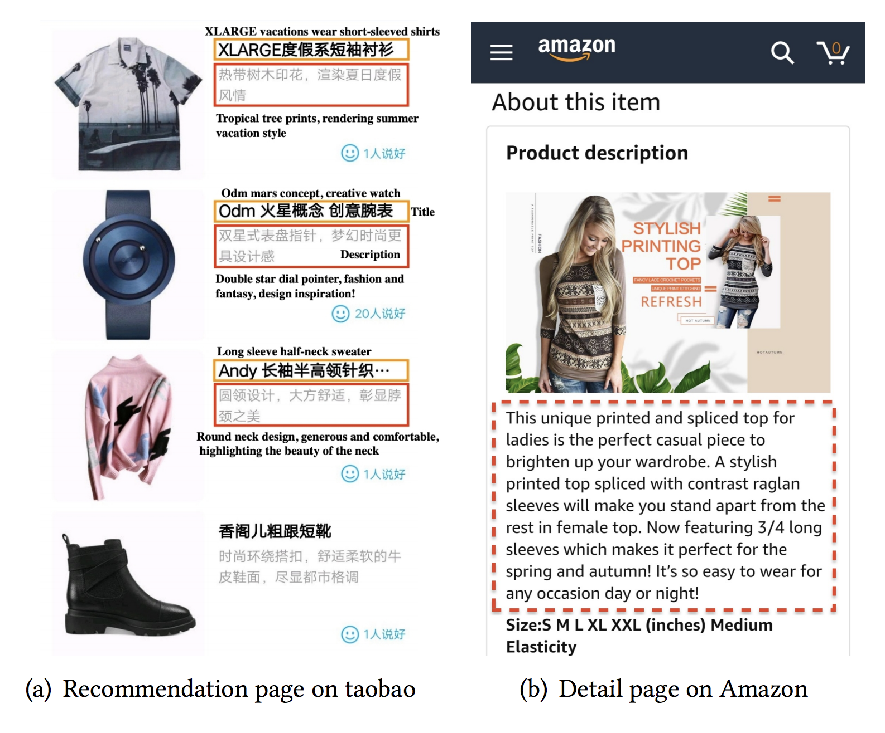
Motivation
online shoppers have paid more and more attention to detailed product descriptions, since a well-written description is a huge factor in making online sales
the writing efficiency of human copywriters cannot match the growth rate of new products

Slide 20
Contributions
put forward a product description generation technology by multi-task learning, which is far advanced than traditional generation method by seq2seq model
introduce a pointer-generator architecture with coordinate encoders (Transformer and Gated CNN)
We intervene in the pattern of the text, such as the length and the style of the product description, to reduce model development period when switching the shopping scenarios and enhance the category accuracy

Slide 21
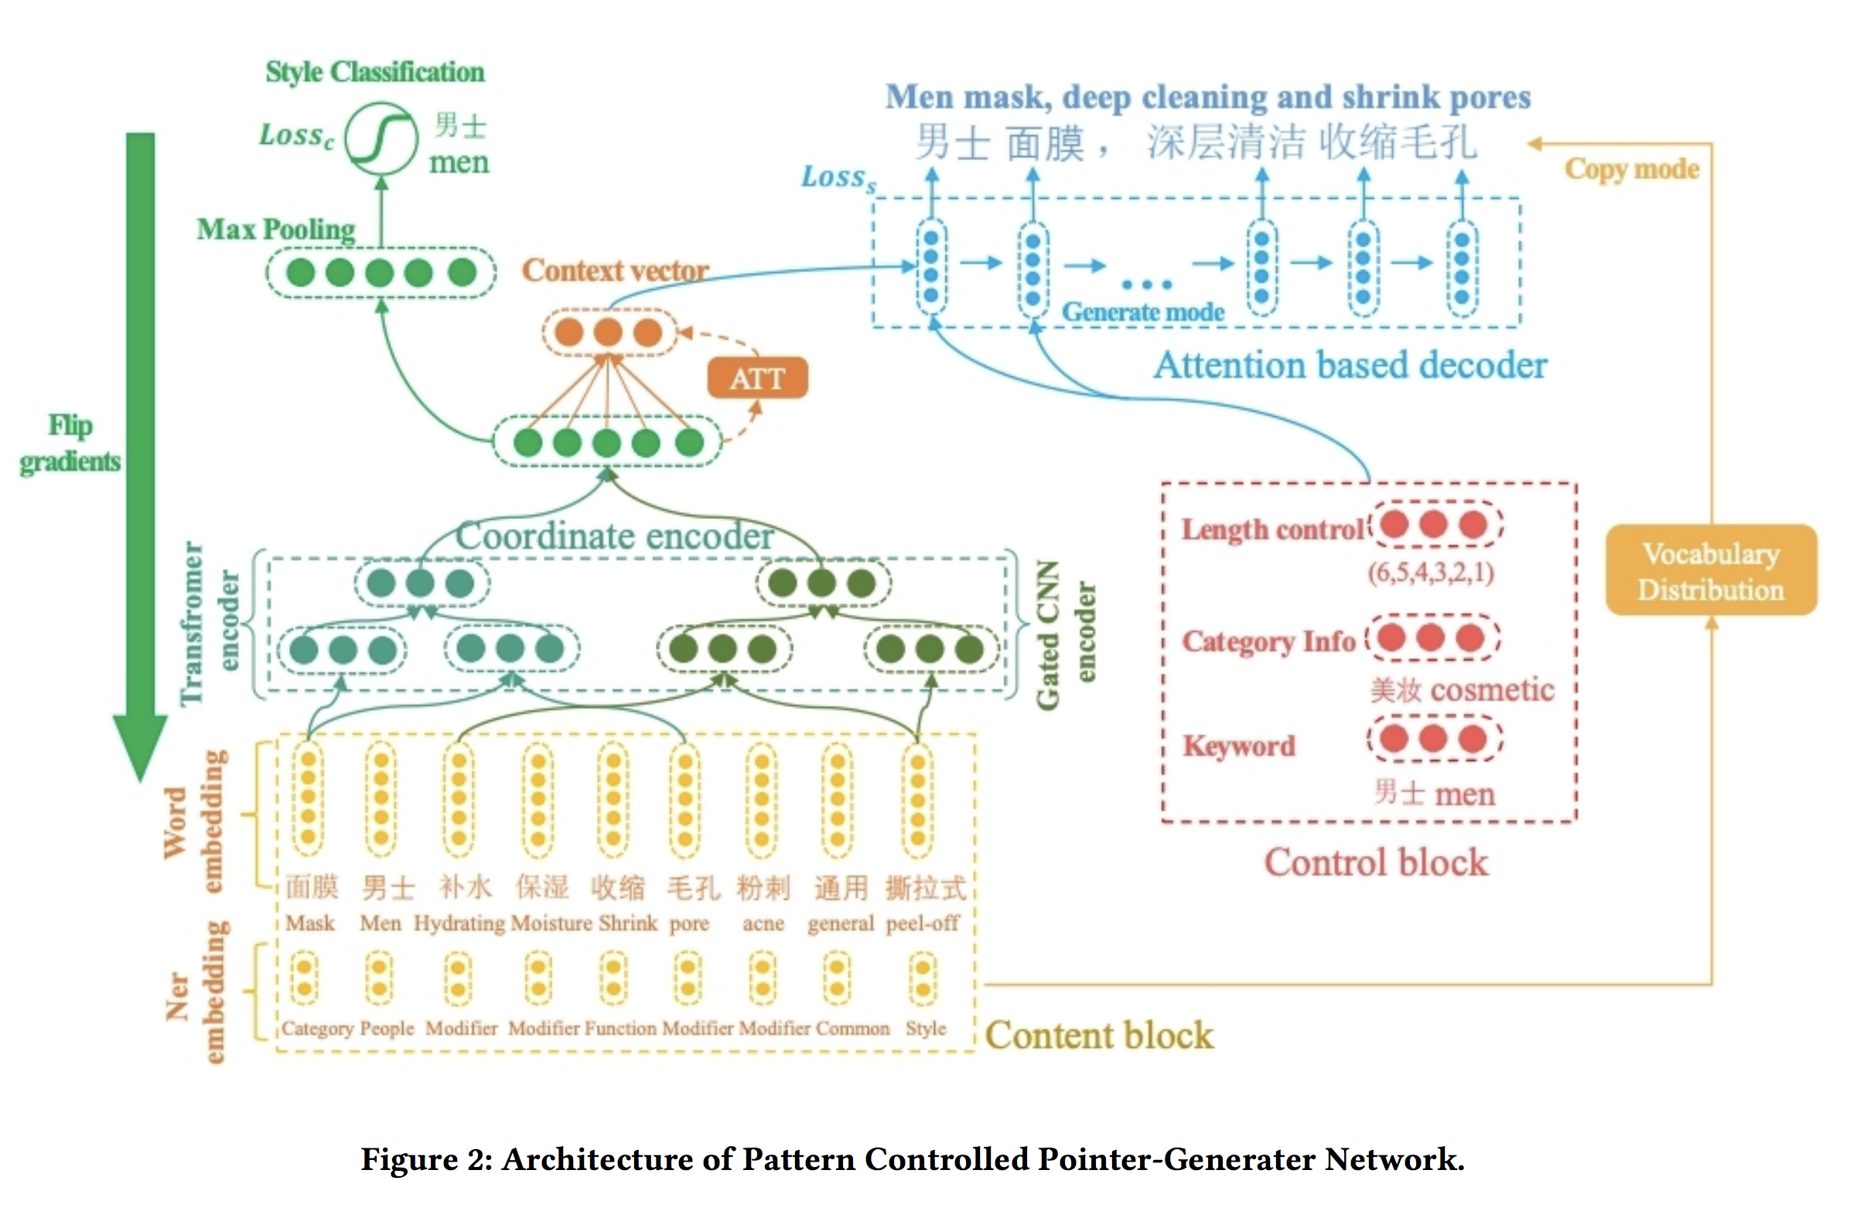
Model

Slide 22
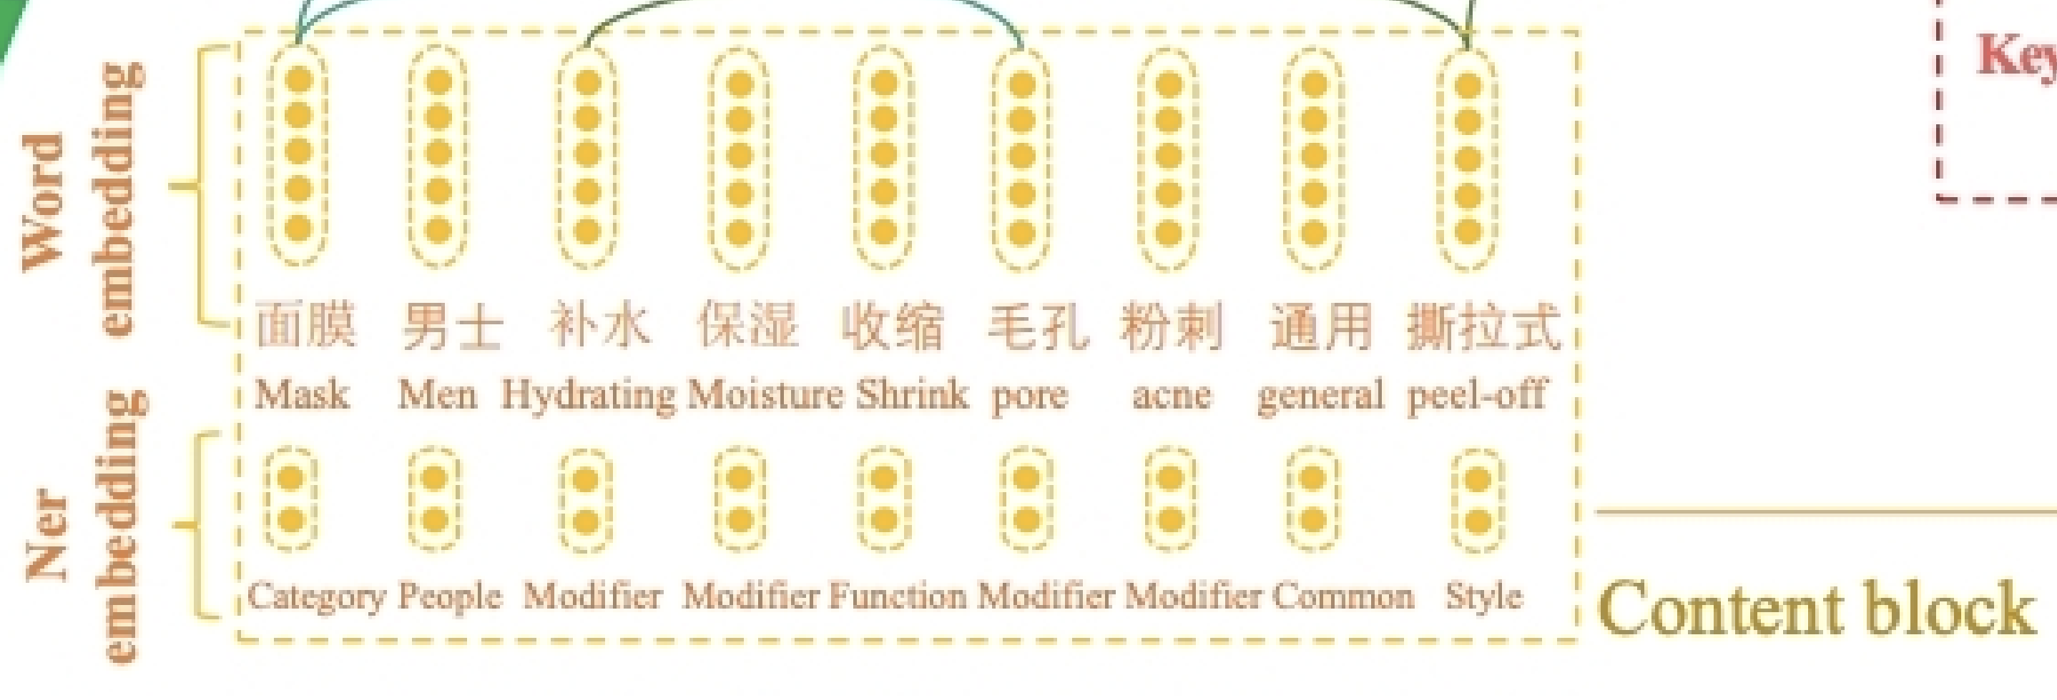
Content Block
use a specialized Named Entity Recognition (NER) tool for E-commerce to label entities in product title

Slide 23
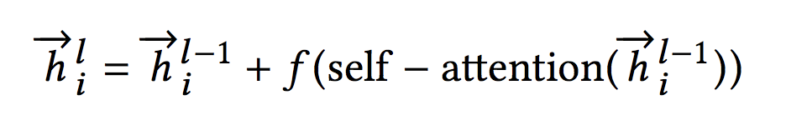
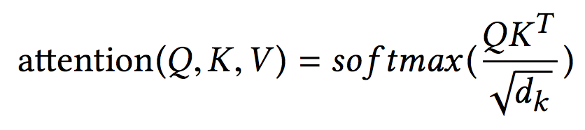
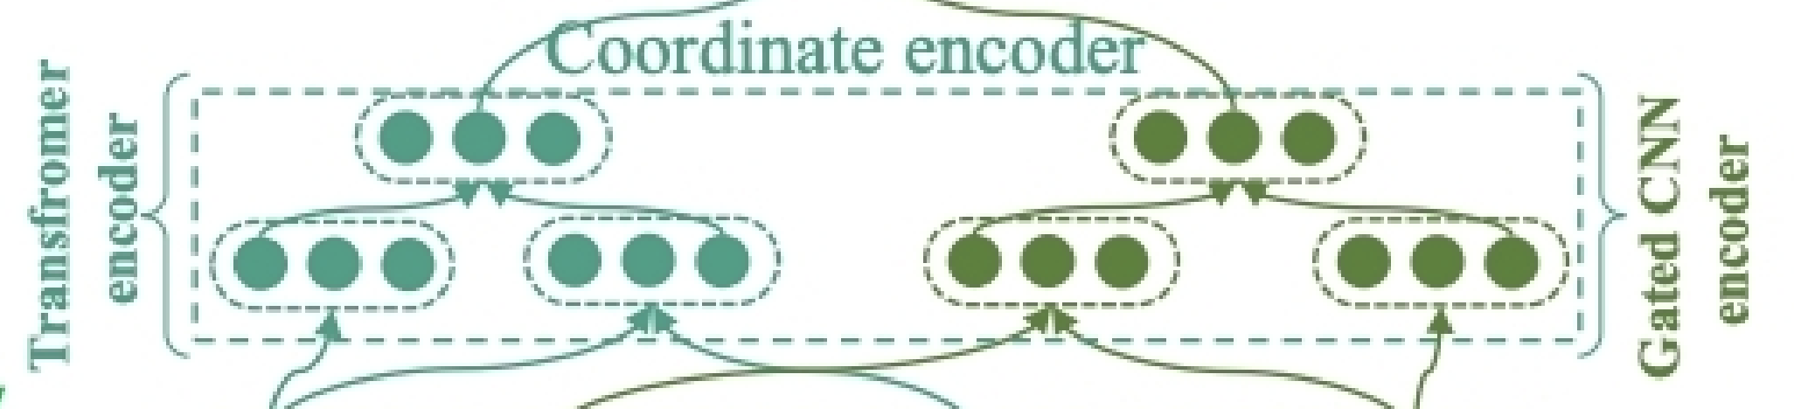
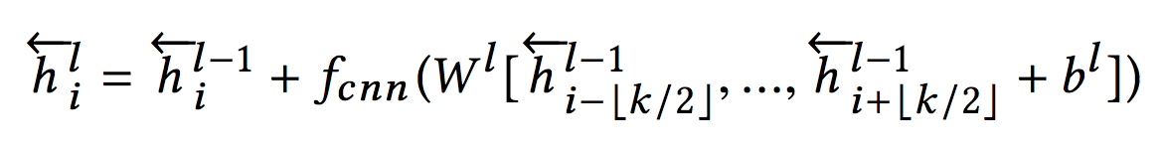
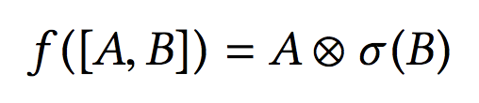
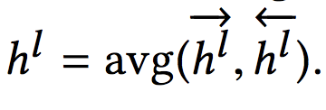
Coordinate Encoder

Slide 24
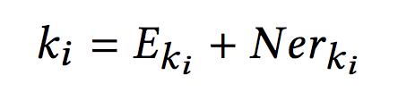
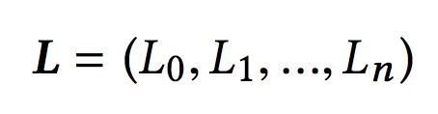
Control Block
Notes:
最后一个公式是多任务的分类任务

Slide 25
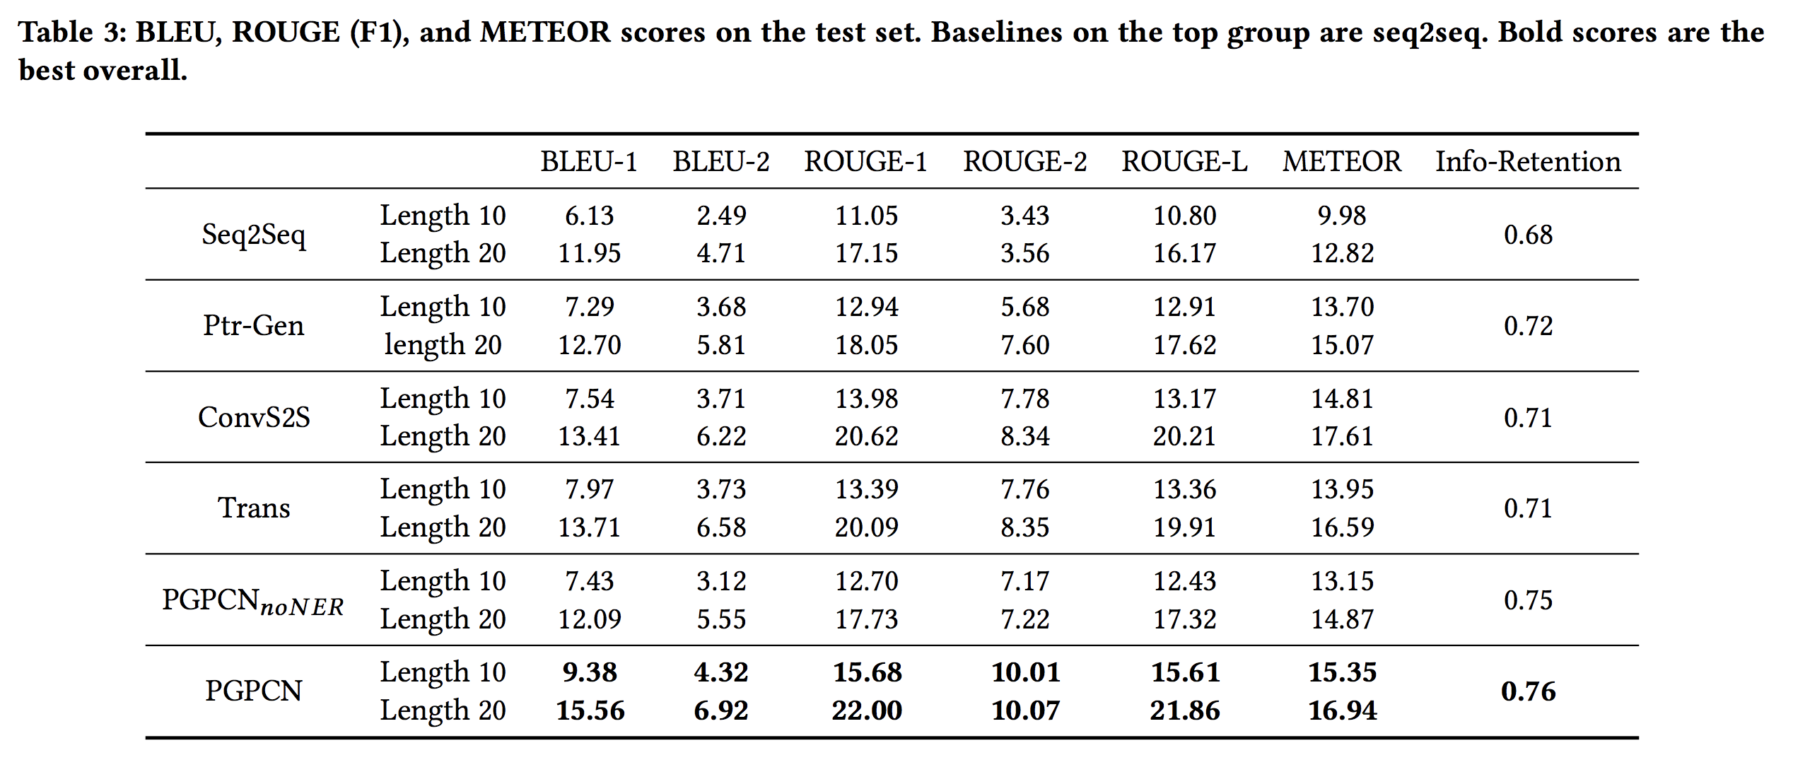
Experiment

Slide 26
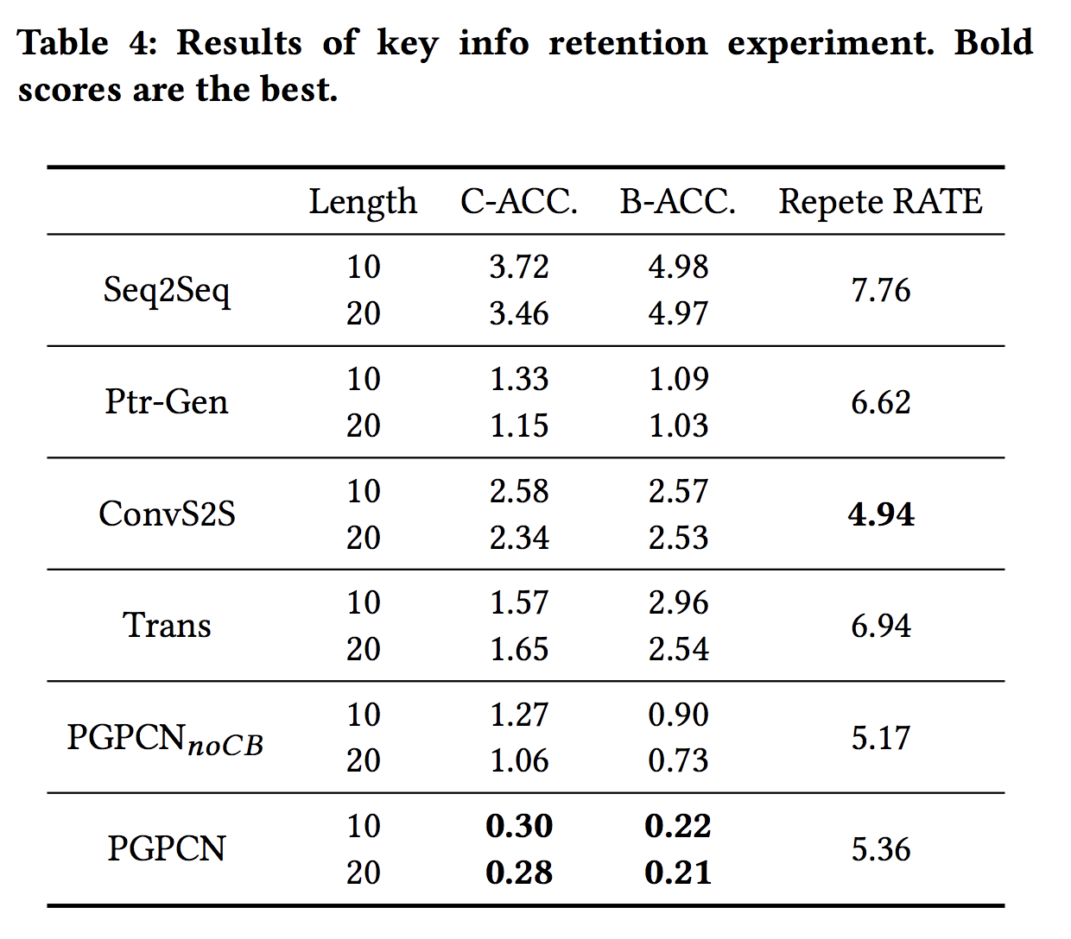
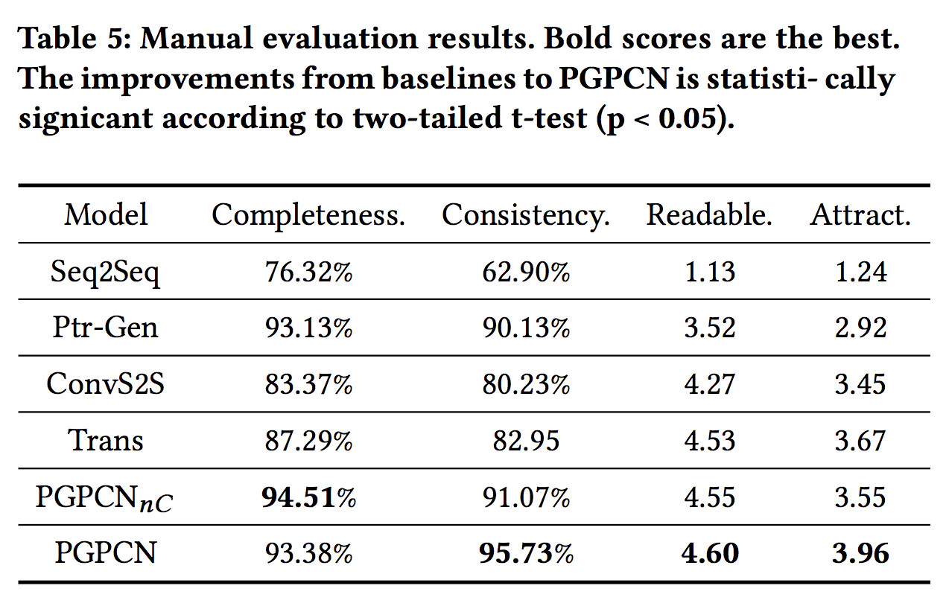
Experiment
Notes:
Completeness：关键信息是否保持在生成的句子中
Consistency：生成的句子的风格是否一致

Slide 27
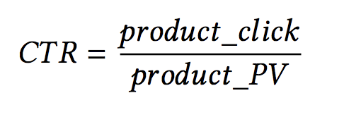
Experiment
Online A/B Testing
Notes:
C是commodity的错误率，商品编号
B是Brand的错误率，商品品牌
Repete RATE：We also calculated the word repetition rate

Slide 28
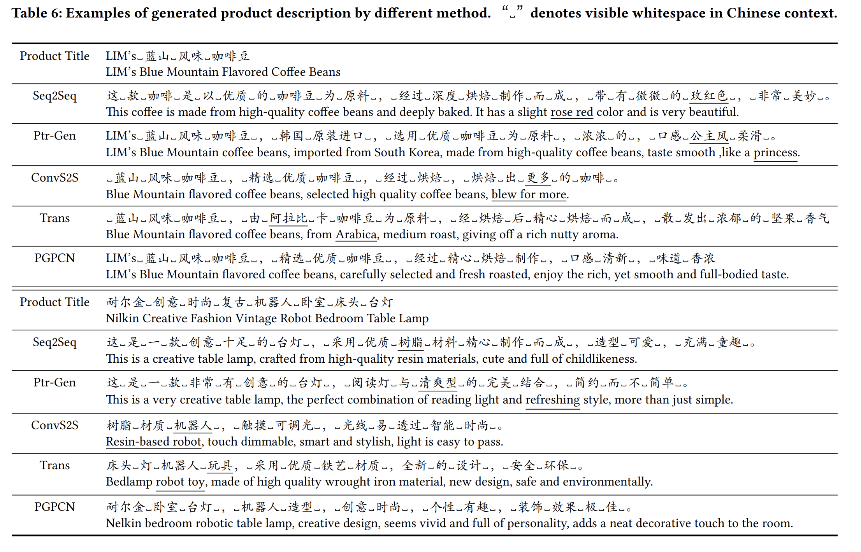
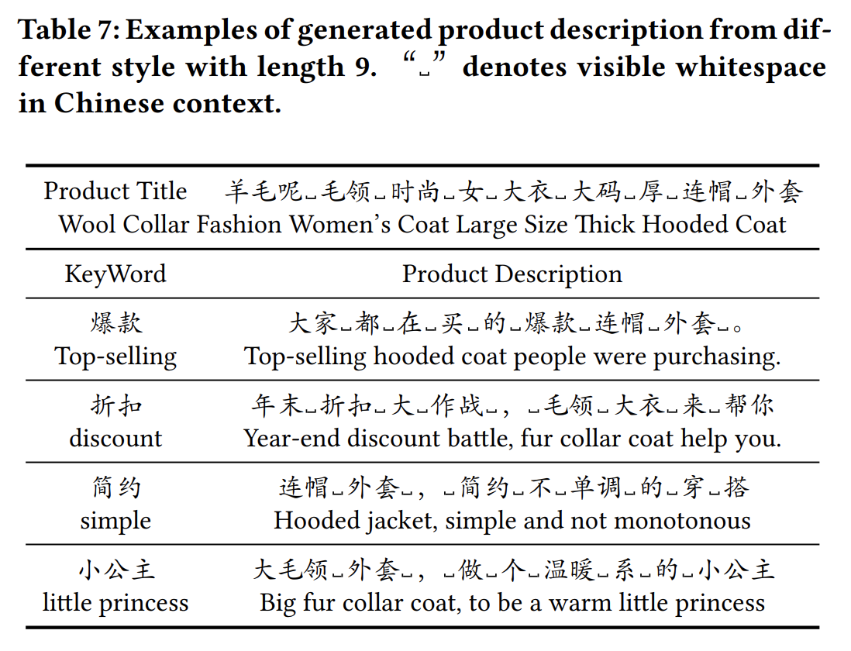
Experiment

Slide 29
Conclusion

Slide 30
Thank you ！

